Slide 1
Callbacks, events
Dr. Adeel Ansari

Slide 2
Topics to be covered
HTTP Module
FS Module
OS Module
URL Module
Event Loops and Event Emitter Class

Slide 3
What is Callback?
Callback is an asynchronous equivalent for a function. A callback function is called at the completion of a given task. Node makes heavy use of callbacks. All the APIs of Node are written in such a way that they support callbacks.
For example, a function to read a file may start reading a file and return the control to the execution environment immediately so that the next instruction can be executed. Once file I/O is complete, it will call the callback function while passing the callback function, the content of the file as a parameter. So there is no blocking or wait for File I/O. This makes Node.js highly scalable, as it can process a high number of requests without waiting for any function to return results.

Slide 4
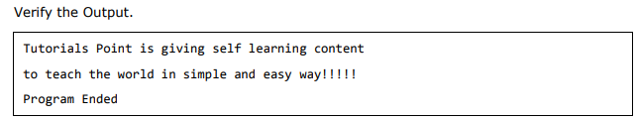
Blocking Code Example
Create a text file named input.txt with some text content.
Create a main.js file with the following code:
var fs = require("fs");
var data = fs.readFileSync('input.txt');
console.log(data.toString());
console.log("Program Ended");

Slide 5
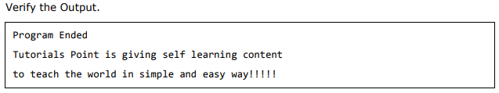
Non-Blocking Code Example
Create a text file named input.txt with some text content.
Create a main.js file with the following code:
var fs = require("fs");
fs.readFile('input.txt', function (err, data) {
if (err) return console.error(err);
console.log(data.toString());
});
console.log("Program Ended");

Slide 6
Non-Blocking Asynchronous
These two examples explain the concept of blocking and non-blocking calls.
The first example shows that the program blocks until it reads the file and then only it proceeds to end the program.
The second example shows that the program does not wait for file reading and proceeds to print "Program Ended" and at the same time, the program without blocking continues reading the file.

Slide 7
http module
Dr. Adeel Ansari

Slide 8
Recall the Http code
var http = require('http'); http.createServer(function (req, res) { res.writeHead(200, {'Content-Type': 'text/html'}); res.write('Hello World!'); res.end(); }).listen(8080);
Only “/” gets printed on the webpage.
The function passed into the http.createServer() has a req argument that represents the request from the client, as an object (http.IncomingMessage object).
This object has a property called "url" which holds the part of the url that comes after the domain name:

Slide 9
Split the Query String
There are built-in modules to easily split the query string into readable parts, such as the URL module.
const http = require('http'); const url = require('url'); http.createServer( (req, res)=> { res.writeHead(200, {'Content-Type': 'text/html'}); var q = url.parse(req.url, true).query; var txt = q.year + " " + q.month; res.end(txt); }).listen(8080);

Slide 10
fs module
Dr. Adeel Ansari

Slide 11
Node.js as a File Server
The Node.js file system module allows you to work with the file system on your computer.
To include the File System module, use the require() method:
var fs = require('fs');
Common use for the File System module:
Read files
Create files
Update files
Delete files
Rename files

Slide 12
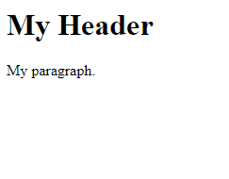
Read Files
The fs.readFile() method is used to read files on your computer.
If you have followed the same steps on your computer, you will see the same result as the example: http://localhost:8080
var http = require('http'); var fs = require('fs'); http.createServer(function (req, res) { fs.readFile('demofile1.html', function(err, data) { res.writeHead(200, {'Content-Type': 'text/html'}); res.write(data); res.end(); }); }).listen(8080);

Slide 13
Create Files
The File System module has methods for creating new files:
fs.appendFile()
fs.open()
fs.writeFile()
The fs.appendFile() method appends specified content to a file. If the file does not exist, the file will be created

Slide 14
Create a new file using the appendFile() method:
var fs = require('fs'); fs.appendFile('mynewfile1.txt', 'Hello Content!', function (err) { if (err) throw err; console.log('Saved!'); });

Slide 15
Create a new file using the Open() method:
The fs.open() method takes a "flag" as the second argument, if the flag is "w" for "writing", the specified file is opened for writing. If the file does not exist, an empty file is created:
var fs = require('fs'); fs.open('mynewfile2.txt', 'w', function (err, file) { if (err) throw err; console.log('Saved!'); });

Slide 16
Create a new file using the writeFile() method:
The fs.writeFile() method replaces the specified file and content if it exists. If the file does not exist, a new file, containing the specified content, will be created:
var fs = require('fs'); fs.writeFile('mynewfile3.txt', 'Hello content!', function (err) { if (err) throw err; console.log('Saved!'); });

Slide 17
Update Files
The File System module has methods for updating files:
fs.appendFile()
fs.writeFile()
The fs.appendFile() method appends the specified content at the end of the specified file:
var fs = require('fs'); fs.appendFile('mynewfile1.txt', ' This is my text.', function (err) { if (err) throw err; console.log('Updated!'); });

Slide 18
Update Files
The fs.writeFile() method replaces the specified file and content:
var fs = require('fs'); fs.writeFile('mynewfile3.txt', 'This is my text', function (err) { if (err) throw err; console.log('Replaced!'); });
Replace the content of the file "mynewfile3.txt":

Slide 19
Delete Files
To delete a file with the File System module, use the fs.unlink() method.
The fs.unlink() method deletes the specified file:
var fs = require('fs'); fs.unlink('mynewfile2.txt', function (err) { if (err) throw err; console.log('File deleted!'); });

Slide 20
Rename Files
To rename a file with the File System module, use the fs.rename() method.
The fs.rename() method renames the specified file:
var fs = require('fs'); fs.rename('mynewfile1.txt', 'myrenamedfile.txt', function (err) { if (err) throw err; console.log('File Renamed!'); });

Slide 21
os module
Dr. Adeel Ansari

Slide 22
Nodejs os module
This module provides many functions that you can use to retrieve information from the underlying operating system and the computer the program runs on, and interact with it.
const os = require('os')
Let's now see the main methods that os provides:
os.arch()
Return the string that identifies the underlying architecture, like arm, x64, arm64.

Slide 23
Nodejs os module
os.cpus()
Return information on the CPUs available on your system.
os.hostname()
Return the hostname.
os.platform()
Return the platform that Node.js was compiled for.
os.type()
Identifies the operating system:
Linux
Darwin on macOS
Windows_NT on Windows

Slide 24
URL module
Dr. Adeel Ansari

Slide 25
The Built-in URL Module
The URL module splits up a web address into readable parts.
To include the URL module, use the require() method:
var url = require('url');
Parse an address with the url.parse() method, and it will return a URL object with each part of the address as properties:

Slide 26
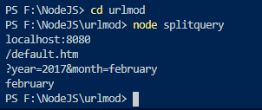
Split a web address into readable parts:
var url = require('url'); var adr = 'http://localhost:8080/default.htm?year=2017&month=february'; var q = url.parse(adr, true); console.log(q.host); //returns 'localhost:8080' console.log(q.pathname); //returns '/default.htm' console.log(q.search); //returns '?year=2017&month=february' var qdata = q.query; //returns an object: { year: 2017, month: 'february' } console.log(qdata.month); //returns 'february'

Slide 27
Node.js File Server
Now we know how to parse the query string, and in the previous chapter we learned how to make Node.js behave as a file server. Let us combine the two, and serve the file requested by the client.
Create two html files and save them in the same folder as your node.js files.
summer.html
<!DOCTYPE html> <html> <body> <h1>Summer</h1> <p>I love the sun!</p> </body> </html>
winter.html
<!DOCTYPE html> <html> <body> <h1>Winter</h1> <p>I love the snow!</p> </body> </html>

Slide 28
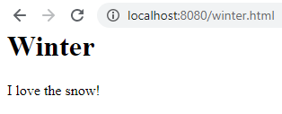
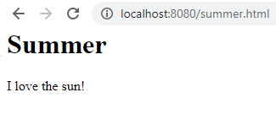
Node.js File Server
var http = require('http'); var url = require('url'); var fs = require('fs'); http.createServer(function (req, res) { var q = url.parse(req.url, true); var filename = "." + q.pathname; fs.readFile(filename, function(err, data) { if (err) { res.writeHead(404, {'Content-Type': 'text/html'}); return res.end("404 Not Found"); } res.writeHead(200, {'Content-Type': 'text/html'}); res.write(data); return res.end(); }); }).listen(8080);
Create a Node.js file that opens the requested file and returns the content to the client. If anything goes wrong, throw a 404 error:
http://localhost:8080/winter.html
http://localhost:8080/summer.html

Slide 29
Event loop
Dr. Adeel Ansari

Slide 30
Event loop
Node.js is a single-threaded application, but it can support concurrency via the concept of event and callbacks.
Every API of Node.js is asynchronous and being single-threaded, they use async function calls to maintain concurrency. Node uses observer pattern.
Node thread keeps an event loop and whenever a task gets completed, it fires the corresponding event which signals the event-listener function to execute.

Slide 31
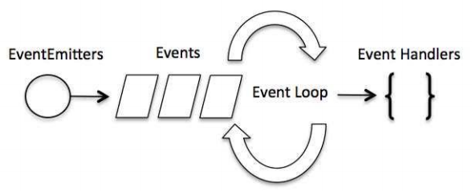
Event-Driven Programming
Node.js uses events heavily and it is also one of the reasons why Node.js is pretty fast compared to other similar technologies.
As soon as Node starts its server, it simply initiates its variables, declares functions, and then simply waits for the event to occur.
In an event-driven application, there is generally a main loop that listens for events, and then triggers a callback function when one of those events is detected.

Slide 32
Event-Driven Programming
Although events look quite similar to callbacks, the difference lies in the fact that callback functions are called when an asynchronous function returns its result, whereas event handling works on the observer pattern. The functions that listen to events act as Observers. Whenever an event gets fired, its listener function starts executing.
Node.js has multiple inbuilt events available through events module and EventEmitter class which are used to bind events and event-listeners as follows:
// Import events module
var events = require('events');
// Create an eventEmitter object
var eventEmitter = new events.EventEmitter();

Slide 33
Event-Driven Programming
Following is the syntax to bind an event handler with an event:
// Bind event and even handler as follows
eventEmitter.on('eventName', eventHandler);
We can fire an event programmatically as follows:
// Fire an event
eventEmitter.emit('eventName');

Slide 34
Event-Driven Programming
You can assign event handlers to your own events with the EventEmitter object.
In the example here we have created a function that will be executed when a "scream" event is fired.
To fire an event, use the emit() method.
var events = require('events'); var eventEmitter = new events.EventEmitter(); //Create an event handler: var myEventHandler = function () { console.log('I hear a scream!'); } //Assign the event handler to an event: eventEmitter.on('scream', myEventHandler); //Fire the 'scream' event: eventEmitter.emit('scream');

Slide 35

Example
// Import events module
var events = require('events');
// Create an eventEmitter object
var eventEmitter = new events.EventEmitter();
// Create an event handler as follows
var connectHandler = function connected() {
console.log('connection successful.');
// Fire the data_received event
eventEmitter.emit('data_received');
}
// Bind the connection event with the handler
eventEmitter.on('connection', connectHandler);
// Bind the data_received event with the anonymous function
eventEmitter.on('data_received', function(){
console.log('data received successfully.');
});
// Fire the connection event
eventEmitter.emit('connection');
console.log("Program Ended.");

Slide 36
EventEmitter Class
EventEmitter class lies in the events module.
When an EventEmitter instance faces any error, it emits an 'error' event.
When a new listener is added, 'newListener' event is fired and when a listener is removed, 'removeListener' event is fired.
EventEmitter provides multiple properties like on and emit. on property is used to bind a function with the event and emit is used to fire an event.

Slide 37
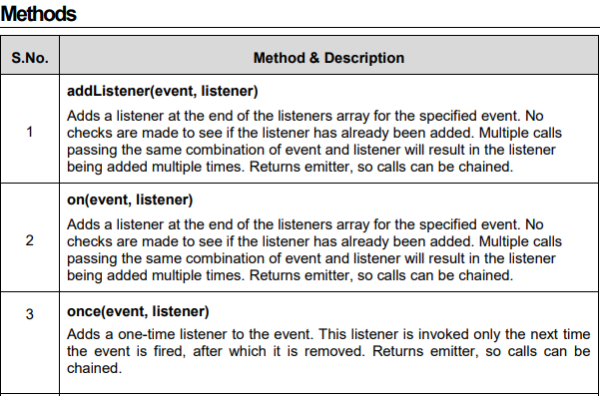

Slide 38
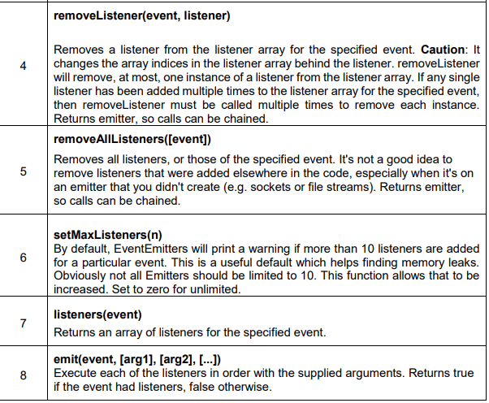

Slide 39
var events = require('events');
var eventEmitter = new events.EventEmitter();
// listener #1
var listner1 = function listner1() {
console.log('listner1 executed.');
}
// listener #2
var listner2 = function listner2() {
console.log('listner2 executed.');
}
// Bind the connection event with the listner1 function
eventEmitter.addListener('connection', listner1);
// Bind the connection event with the listner2 function
eventEmitter.on('connection', listner2);
var eventListeners = require('events').EventEmitter.listenerCount(eventEmitter,'connection');

Slide 40
console.log(eventListeners + " Listner(s) listening to connection event");
// Fire the connection event
eventEmitter.emit('connection');
// Remove the binding of listner1 function
eventEmitter.removeListener('connection', listner1);
console.log("Listner1 will not listen now.");
// Fire the connection event
eventEmitter.emit('connection');
eventListeners =require('events').EventEmitter.listenerCount(eventEmitter,'connection');
console.log(eventListeners + " Listner(s) listening to connection event");
console.log("Program Ended.");

Slide 41
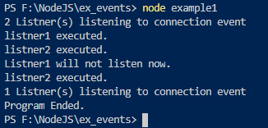
Output

Slide 42
summary

